Slide 1
Some more Artificial Intelligence
Neural Networks please read chapter 19.
Genetic Algorithms
Genetic Programming
Behavior-Based Systems

Slide 2
Background
- Neural Networks can be :
- Biological models
- Artificial models
- Desire to produce artificial systems capable of
sophisticated computations similar to the human brain.

Slide 3
Biological analogy and some main ideas
The brain is composed of a mass of interconnected neurons
  each neuron is connected to many other neurons
Neurons transmit signals to each other
Whether a signal is transmitted is an all-or-nothing event (the electrical potential in the cell body of the neuron is thresholded)
Whether a signal is sent, depends on the strength of the bond (synapse) between two neurons

Slide 4
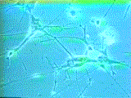
How Does the Brain Work ? (1)
NEURON
- The cell that performs information processing in the brain.
- Fundamental functional unit of all nervous system tissue.

Slide 5
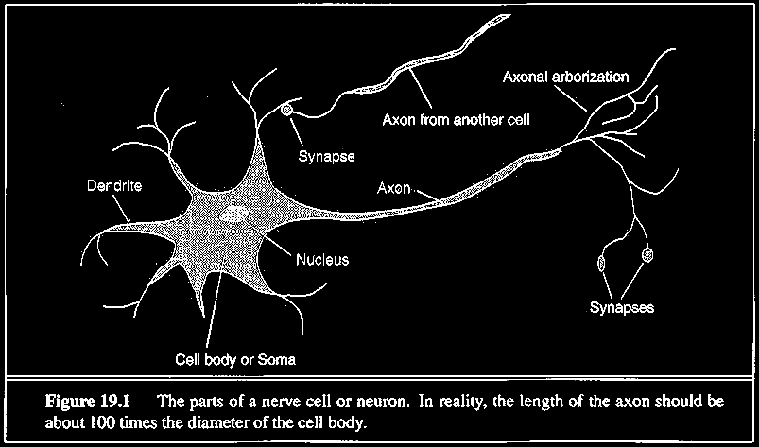
How Does the Brain Work ? (2)
Each consists of :
SOMA, DENDRITES, AXON, and SYNAPSE.

Slide 6
Brain vs. Digital Computers (1)
Computers require hundreds of cycles to simulate
a firing of a neuron.
- The brain can fire all the neurons in a single step.
Parallelism
- Serial computers require billions of cycles to
perform some tasks but the brain takes less than
a second.
e.g. Face Recognition

Slide 7
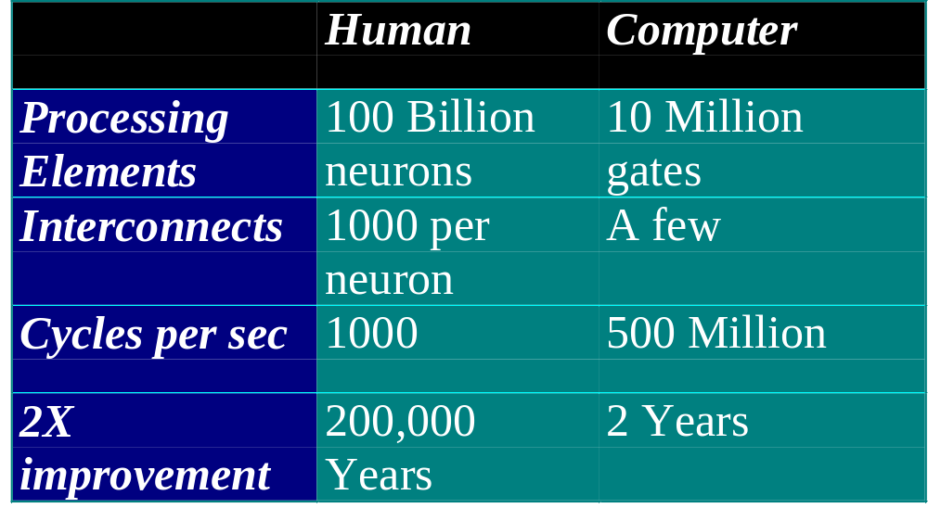
Comparison of Brain and computer

Slide 8
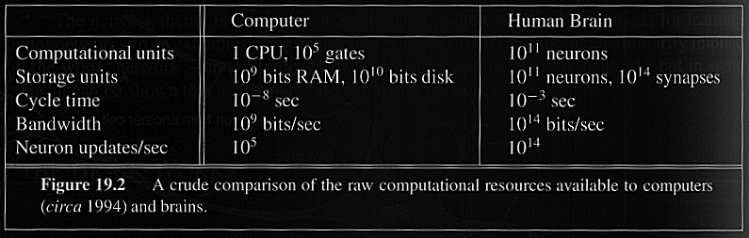
Brain vs. Digital Computers (2)
Future : combine parallelism of the brain with the
switching speed of the computer.

Slide 9
History
1943: McCulloch & Pitts show that neurons can be combined to construct a Turing machine (using ANDs, Ors, & NOTs)
1958: Rosenblatt shows that perceptrons will converge if what they are trying to learn can be represented
1969: Minsky & Papert showed the limitations of perceptrons, killing research for a decade
1985: backpropagation algorithm revitalizes the field

Slide 10
Definition of Neural Network
A Neural Network is a system composed of
many simple processing elements operating in
parallel which can acquire, store, and utilize
experiential knowledge.

Slide 11
What is Artificial Neural Network?

Slide 12
Neurons vs. Units (1)
- Each element of NN is a node called unit.
- Units are connected by links.
- Each link has a numeric weight.

Slide 13
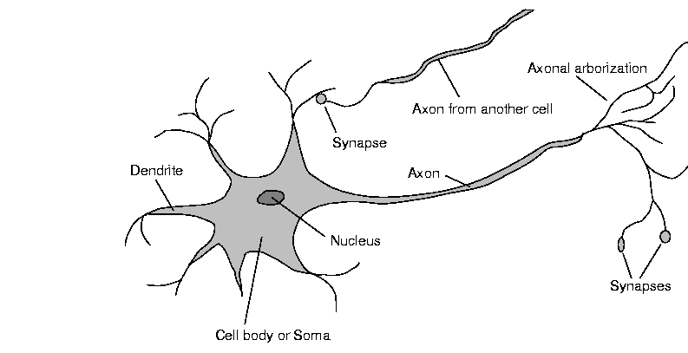
Neurons vs units (2)
Real neuron is far away from our simplified model - unit
Chemistry, biochemistry, quantumness.

Slide 14
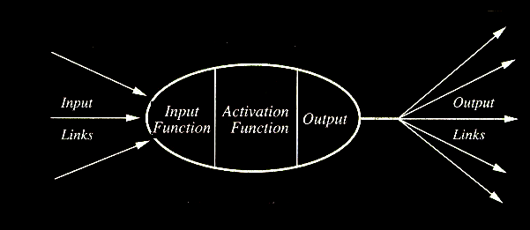
Computing Elements
A typical unit:

Slide 15
Planning in building a Neural Network
Decisions must be taken on the following:
- The number of units to use.
- The type of units required.
- Connection between the units.

Slide 16
How NN learns a task.
Issues to be discussed
- Initializing the weights.
- Use of a learning algorithm.
- Set of training examples.
- Encode the examples as inputs.
- Convert output into meaningful results.

Slide 17
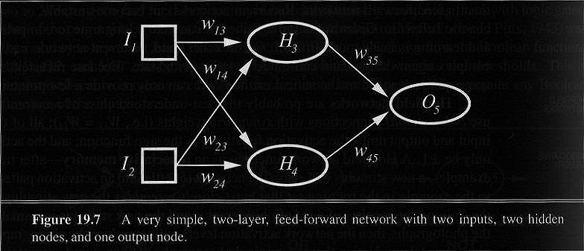
Neural Network Example
Figure 19.7. A very simple, two-layer, feed-forward network with two inputs, two hidden nodes, and one output node.

Slide 18
Simple Computations in this network
- There are 2 types of components: Linear and Non-linear.
- Linear: Input function
- calculate weighted sum of all inputs.
- Non-linear: Activation function
- transform sum into activation level.

Slide 19


Calculations
Input function:
Activation function g:

Slide 20
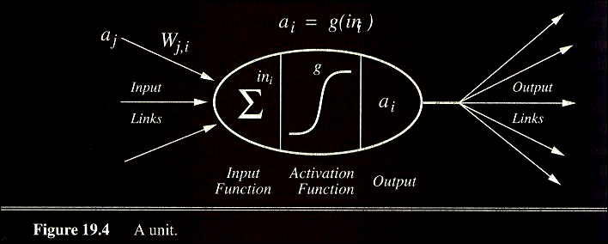
A Computing Unit.
Now in more detail but for a particular model only
Figure 19.4. A unit

Slide 21
Activation Functions
- Use different functions to obtain different models.
- 3 most common choices :
1) Step function
2) Sign function
3) Sigmoid function
- An output of 1 represents firing of a neuron down the axon.

Slide 22
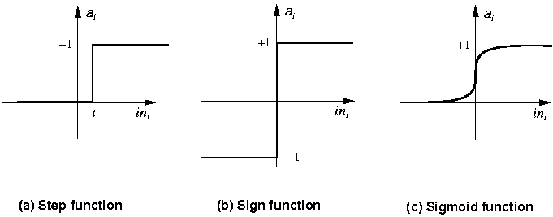
Step Function Perceptrons

Slide 23
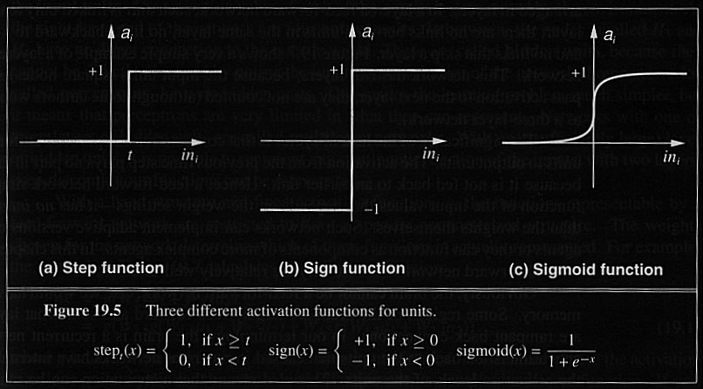
3 Activation Functions

Slide 24
Are current computer a wrong model of thinking?
Humans can’t be doing the sequential analysis we are studying
  Neurons are a million times slower than gates
  Humans don’t need to be rebooted or debugged when one bit dies.

Slide 25
100-step program constraint
Neurons operate on the order of 10⁻³ seconds
Humans can process information in a fraction of a second (face recognition)
Hence, at most a couple of hundred serial operations are possible
That is, even in parallel, no “chain of reasoning” can involve more than 100 -1000 steps

Slide 26
Standard structure of an artificial neural network
Input units
  represents the input as a fixed-length vector of numbers (user defined)
Hidden units
  calculate thresholded weighted sums of the inputs
  represent intermediate calculations that the network learns
Output units
  represent the output as a fixed length vector of numbers

Slide 27
Representations
Logic rules
  If color = red ^ shape = square then +
Decision trees
  tree
Nearest neighbor
  training examples
Probabilities
  table of probabilities
Neural networks
  inputs in [0, 1]
Can be used for all of them
Many variants exist

Slide 28
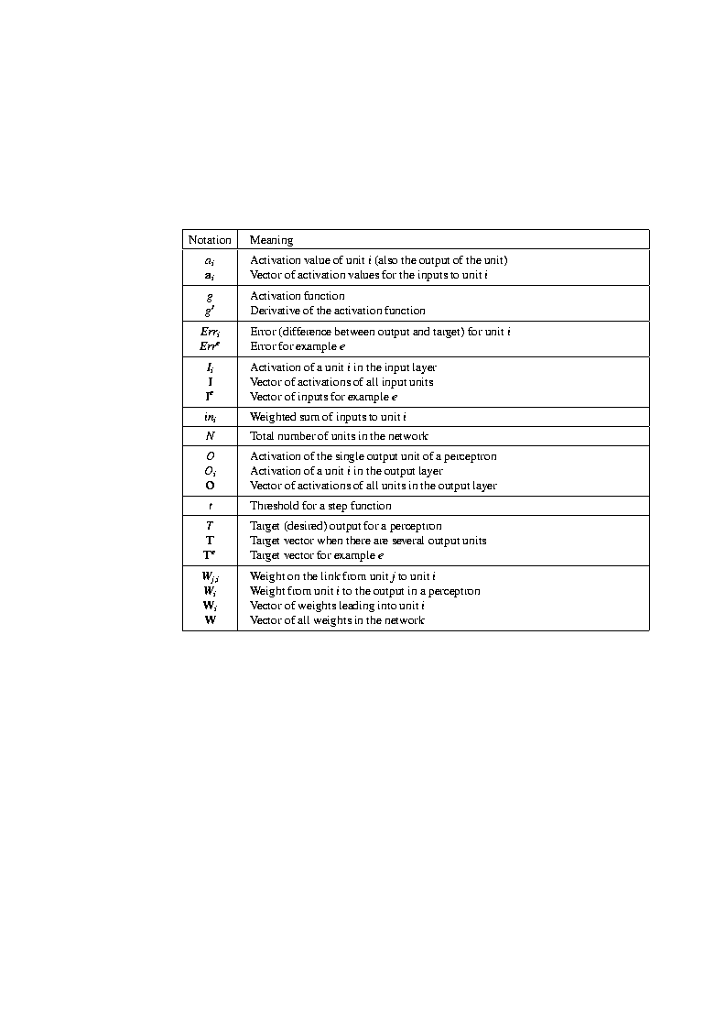
Notation

Slide 29
Notation (cont.)

Slide 30
Operation of individual units
Output_{i} = f(W_{i,j} * Input_{j} + W_{i,k} * Input_{k} + W_{i,l} * Input_{l})
  where f(x) is a threshold (activation) function
  f(x) = 1 / (1 + e^{-Output})
    “sigmoid”
  f(x) = step function

Slide 31
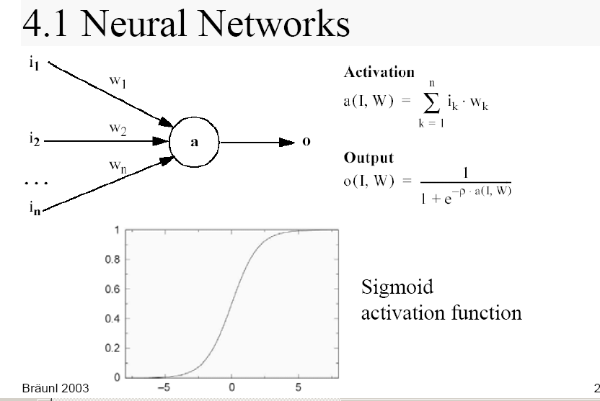
Artificial Neural Networks

Slide 32
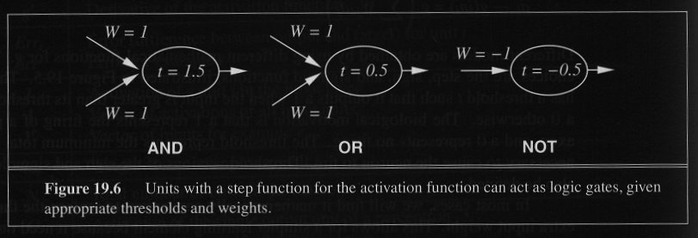
Units in Action
- Individual units representing Boolean functions

Slide 33
Network Structures
Feed-forward neural nets:
Links can only go in one direction.
Recurrent neural nets:
Links can go anywhere and form arbitrary
topologies.

Slide 34
Feed-forward Networks
- Arranged in layers.
- Each unit is linked only in the unit in next layer.
No units are linked between the same layer, back to
the previous layer or skipping a layer.
- Computations can proceed uniformly from input to
output units.
- No internal state exists.

Slide 35
Feed-Forward Example
H3
H5
I1
W₃₅ = 1
W₁₃ = -1
t = -0.5
t = 1.5
I1
W₅₇ = 1
W₂₅ = 1
O7
t = 0.5
W₁₆ = 1
I2
W₆₇ = 1
W₂₄= -1
t = -0.5
t = 1.5
W₄₆ = 1
H4
H6
Inputs skip the layer in this case

Slide 36
Multi-layer Networks and Perceptrons
- Networks without hidden layer are called perceptrons.
- Perceptrons are very limited in what they can represent, but this makes their learning problem much simpler.
- Have one or more layers of hidden units.
- With two possibly very large hidden layers, it is possible to implement any function.

Slide 37
Recurrent Network (1)
- The brain is not and cannot be a feed-forward network.
- Allows activation to be fed back to the previous unit.
- Internal state is stored in its activation level.
Can become unstable
Can oscillate.

Slide 38
Recurrent Network (2)
- May take long time to compute a stable output.
- Learning process is much more difficult.
- Can implement more complex designs.
- Can model certain systems with internal states.

Slide 39
Perceptrons
- First studied in the late 1950s.
- Also known as Layered Feed-Forward Networks.
- The only efficient learning element at that time was
for single-layered networks.
- Today, used as a synonym for a single-layer,
feed-forward network.

Slide 40
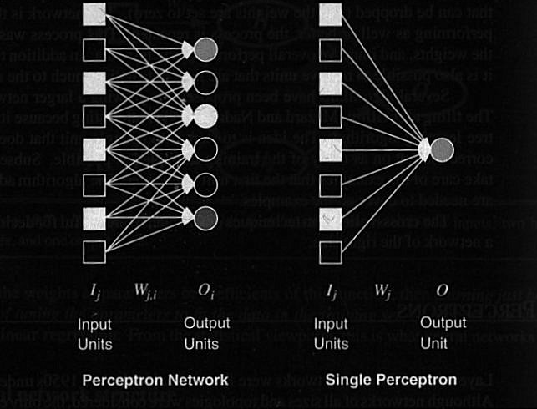
Fig. 19.8. Perceptrons

Slide 41
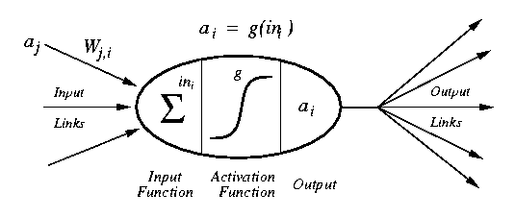
Perceptrons

Slide 42
Sigmoid Perceptron

Slide 43
Perceptron learning rule
Teacher specifies the desired output for a given input
Network calculates what it thinks the output should be
Network changes its weights in proportion to the error between the desired & calculated results
Δw_{i,j} = α * [teacher_{i} - output_{i}] * input_{j}
  where:
  α is the learning rate;
  teacher_{i} - output_{i} is the error term;
  and input_{j} is the input activation
w_{i,j =} w_{i,j} + Δw_{i,j}
Delta rule

Slide 44
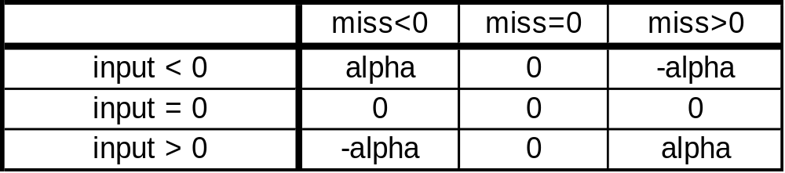
Adjusting perceptron weights
Δw_{i,j} = α * [teacher_{i} - output_{i}] * input_{j}
miss_{i} is (teacher_{i} - output_{i})
Adjust each w_{i,j} based on input_{j} and miss_{i}
The above table shows adaptation.
_{Incremental learning.}

Slide 45
Node biases
A node’s output is a weighted function of its inputs
What is a bias?
How can we learn the bias value?
Answer: treat them like just another weight

Slide 46
Training biases (Θ)
A node’s output:
  1 if w₁x₁ + w₂x₂ + … + w_{n}x_{n} >= Θ
  0 otherwise
Rewrite
  w₁x₁ + w₂x₂ + … + w_{n}x_{n} - Θ >= 0
  w₁x₁ + w₂x₂ + … + w_{n}x_{n} + Θ(-1) >= 0
Hence, the bias is just another weight whose activation is always -1
Just add one more input unit to the network topology
bias

Slide 47
Perceptron convergence theorem
If a set of <input, output> pairs are learnable (representable), the delta rule will find the necessary weights
  in a finite number of steps
  independent of initial weights
However, a single layer perceptron can only learn linearly separable concepts
  it works iff gradient descent works

Slide 48
Linear separability
Consider a perceptron
Its output is
  1, if W₁X₁ + W₂X₂ > Θ
  0, otherwise
In terms of feature space
  hence, it can only classify examples if a line (hyperplane more generally) can separate the positive examples from the negative examples

Slide 49
What can Perceptrons Represent ?
- Some complex Boolean function can be represented.
For example:
Majority function - will be covered in this lecture.
- Perceptrons are limited in the Boolean functions they can represent.

Slide 50
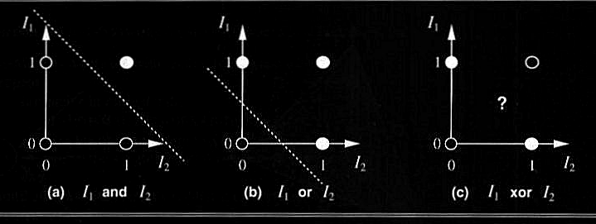
The Separability Problem and EXOR trouble
Figure 19.9. Linear Separability in Perceptrons

Slide 51
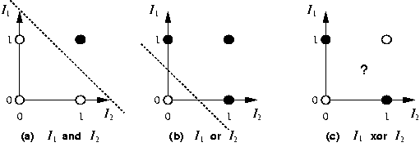
AND and OR linear Separators

Slide 52
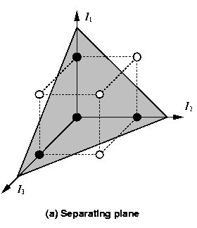
Separation in n-1 dimensions
majority
Example of 3Dimensional space

Slide 53
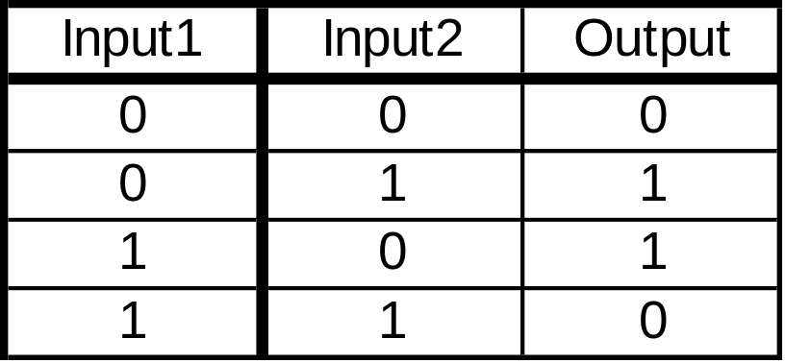
Perceptrons & XOR
XOR function
  no way to draw a line to separate the positive from negative examples

Slide 54
How do we compute XOR?

Slide 55
Learning Linearly Separable Functions (1)
What can these functions learn ?
Bad news:
- There are not many linearly separable functions.
Good news:
- There is a perceptron algorithm that will learn
any linearly separable function, given enough
training examples.

Slide 56
Learning Linearly Separable Functions (2)
Most neural network learning algorithms, including the
perceptrons learning method, follow the current-best-
hypothesis (CBH) scheme.

Slide 57
Learning Linearly Separable Functions (3)
- Initial network has a randomly assigned weights.
- Learning is done by making small adjustments in the weights to reduce the difference between the observed and predicted values.
- Main difference from the logical algorithms is the need to repeat the update phase several times in order to achieve
convergence.
Updating process is divided into epochs.
Each epoch updates all the weights of the process.

Slide 58
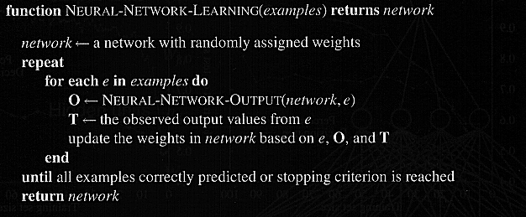
Figure 19.11. The Generic Neural Network Learning Method: adjust the weights until predicted output values O and true values T agree
e are examples from set examples

Slide 59
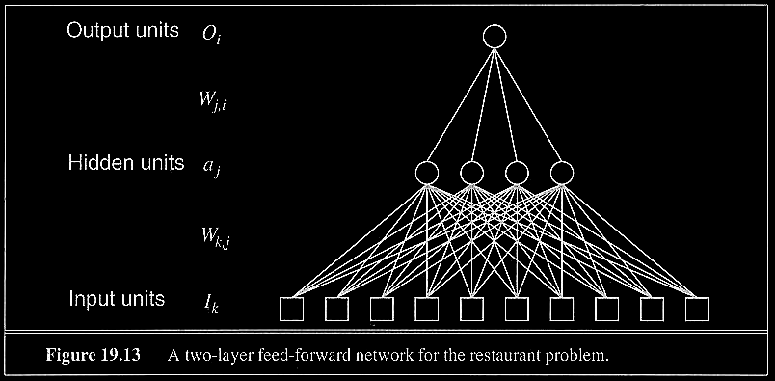
Two types of networks were compared for the restaurant problem
Examples of Feed-Forward Learning

Slide 60
Multi-Layer Neural Nets

Slide 61
Feed Forward Networks

Slide 62
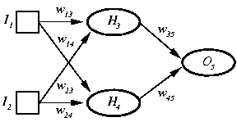
2-layer Feed Forward example

Slide 63
Need for hidden units
If there is one layer of enough hidden units, the input can be recoded (perhaps just memorized; example)
This recoding allows any mapping to be represented
Problem: how can the weights of the hidden units be trained?

Slide 64
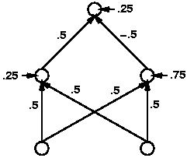
XOR Solution

Slide 65
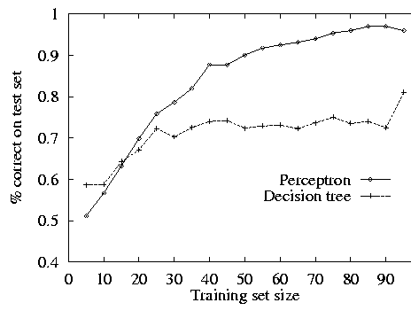
Majority of 11 Inputs
(any 6 or more)
Perceptron is better than DT on majority
Constructive induction is even better than NN
How many times in battlefield the robot recognizes majority?

Slide 66
Other Examples
Need more than a 1-layer network for:
  Parity
  Error Correction
  Connected Paths
Neural nets do well with
  continuous inputs and outputs
But poorly with
  logical combinations of boolean inputs
Give DT brain to a mathematician robot and a NN brain to a soldier robot

Slide 67
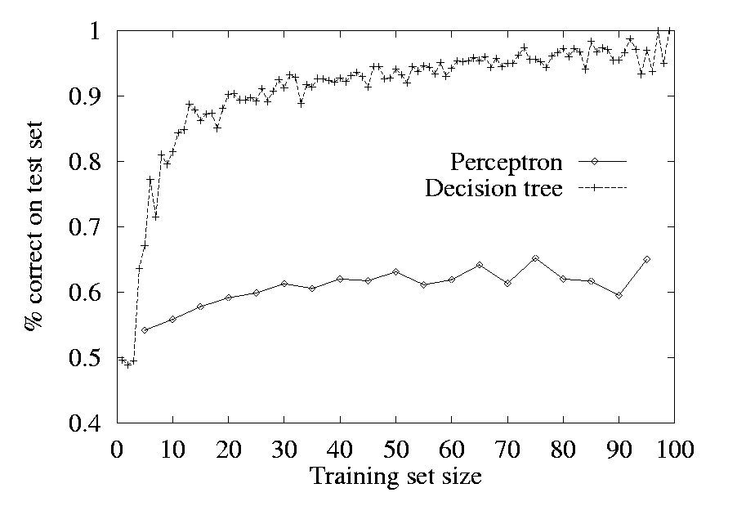
WillWait Restaurant example
Here decision tree is better than perceptron
Let us not dramatize “universal” benchmarks too much

Slide 68
N-layer FeedForward Network
Layer 0 is input nodes
Layers 1 to N-1 are hidden nodes
Layer N is output nodes
All nodes at any layer k are connected to all nodes at layer k+1
There are no cycles

Slide 69
2 Layer FF net with LTUs
Linear Threshold Units
1 output layer + 1 hidden layer
  Therefore, 2 stages to “assign reward”
Can compute functions with convex regions
Each hidden node acts like a perceptron, learning a separating line
Output units can compute intersections of half-planes given by hidden units

Slide 70
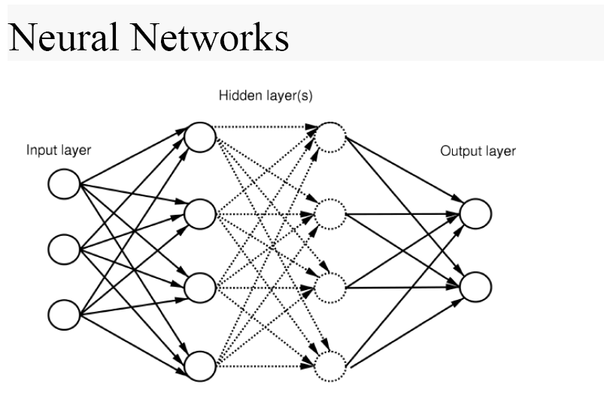
Feed-forward NN with hidden layer

Slide 71
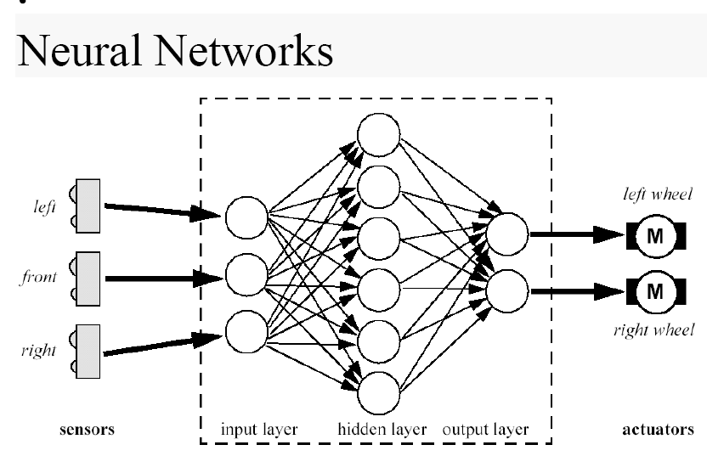
Reactive architecture based on NN for a simple robot
Braitenberg Vehicles
Quantum Neural BV

Slide 72
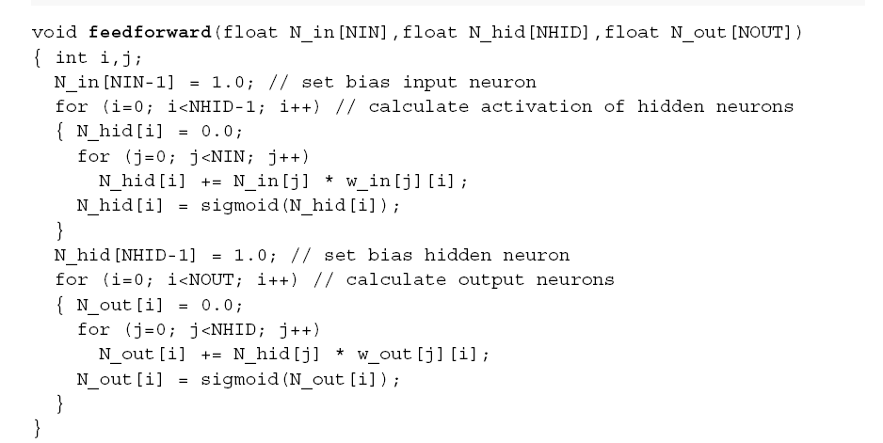
Evaluation of a Feedforward NN using software is easy
Set bias input neuron
Calculate activation of hidden neurons
Calculate output neurons
Take from hidden neurons and multiply by weights

Slide 73
Backpropagation Networks

Slide 74
Introduction to Backpropagation
- In 1969 a method for learning in multi-layer network,
Backpropagation, was invented by Bryson and Ho.
- The Backpropagation algorithm is a sensible approach
for dividing the contribution of each weight.
- Works basically the same as perceptrons

Slide 75
Backpropagation Learning Principles: Hidden Layers and Gradients
There are two differences for the updating rule :
1) The activation of the hidden unit is used instead of the
input value.
2) The rule contains a term for the gradient of the activation
function.

Slide 76
Backpropagation Network training
1. Initialize network with random weights
2. For all training cases (called examples):
  a. Present training inputs to network and calculate output
  b. For all layers (starting with output layer, back to input layer):
    i. Compare network output with correct output
    (error function)
    ii. Adapt weights in current layer
This is what you want

Slide 77
Backpropagation Learning Details
Method for learning weights in feed-forward (FF) nets
Can’t use Perceptron Learning Rule
  no teacher values are possible for hidden units
Use gradient descent to minimize the error
  propagate deltas to adjust for errors
  backward from outputs
  to hidden layers
  to inputs
forward
backward

Slide 78
Backpropagation Algorithm – Main Idea – error in hidden layers
The ideas of the algorithm can be summarized as follows :
Computes the error term for the output units using the
observed error.
2. From output layer, repeat
  propagating the error term back to the previous layer and
  updating the weights between the two layers
  until the earliest hidden layer is reached.

Slide 79
Backpropagation Algorithm
Initialize weights (typically random!)
Keep doing epochs
  For each example e in training set do
    forward pass to compute
      O = neural-net-output(network,e)
      miss = (T-O) at each output unit
    backward pass to calculate deltas to weights
    update all weights
  end
until tuning set error stops improving
Forward pass explained earlier
Backward pass explained in next slide

Slide 80
Backward Pass
Compute deltas to weights
  from hidden layer
  to output layer
Without changing any weights (yet), compute the actual contributions
  within the hidden layer(s)
  and compute deltas

Slide 81
Gradient Descent
Think of the N weights as a point in an N-dimensional space
Add a dimension for the observed error
Try to minimize your position on the “error surface”

Slide 82
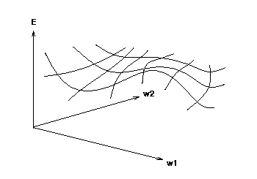
Error Surface
error
weights
Error as function of weights in multidimensional space

Slide 83
Gradient
Compute deltas
Trying to make error decrease the fastest
Compute:
  Grad_{E} = [dE/dw1, dE/dw2, . . ., dE/dwn]
Change i-th weight by
  delta_{wi} = -alpha * dE/dwi
We need a derivative!
Activation function must be continuous, differentiable, non-decreasing, and easy to compute
Derivatives of error for weights

Slide 84
Can’t use LTU
To effectively assign credit / blame to units in hidden layers, we want to look at the first derivative of the activation function
Sigmoid function is easy to differentiate and easy to compute forward
Linear Threshold Units
Sigmoid function

Slide 85
Updating hidden-to-output
We have teacher supplied desired values
delta_{wji} = α * a_{j} * (T_{i} - Oi) * g’(in_{i})
  = α * a_{j} * (T_{i} - O_{i}) * O_{i} * (1 - O_{i})
  for sigmoid the derivative is, g’(x) = g(x) * (1 - g(x))
derivative
alpha
Here we have general formula with derivative, next we use for sigmoid
miss

Slide 86
Updating interior weights
Layer k units provide values to all layer k+1 units
  “miss” is sum of misses from all units on k+1
  miss_{j} = Σ [ a_{i}(1- a_{i}) (T_{i} - a_{i}) w_{ji} ]
  weights coming into this unit are adjusted based on their contribution
  delta_{kj} = α * I_{k} * a_{j} * (1 - a_{j}) * miss_{j}
For layer k+1
Compute deltas

Slide 87
How do we pick α?
Tuning set, or
Cross validation, or
Small for slow, conservative learning

Slide 88
How many hidden layers?
Usually just one (i.e., a 2-layer net)
How many hidden units in the layer?
  Too few ==> can’t learn
  Too many ==> poor generalization

Slide 89
How big a training set?
Determine your target error rate, e
Success rate is 1- e
Typical training set approx. n/e, where n is the number of weights in the net
Example:
  e = 0.1, n = 80 weights
  training set size 800
  trained until 95% correct training set classification
  should produce 90% correct classification
  on testing set (typical)

Slide 90
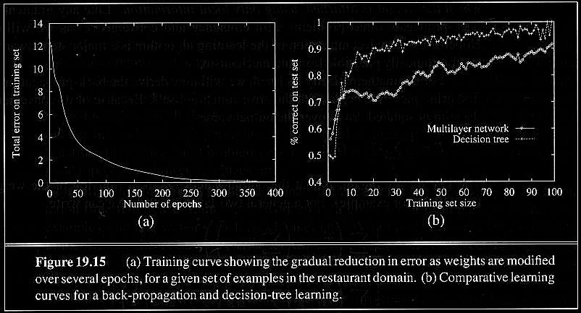
Examples of Backpropagation Learning
In the restaurant problem NN was worse than the decision tree
Error decreases with number of epochs
Decision tree still better for restaurant example

Slide 91
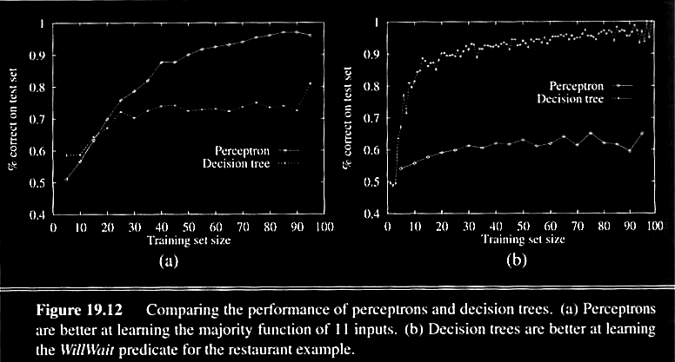
Examples of Backpropagation Learning
Majority example, perceptron better
Restaurant example, DT better

Slide 92
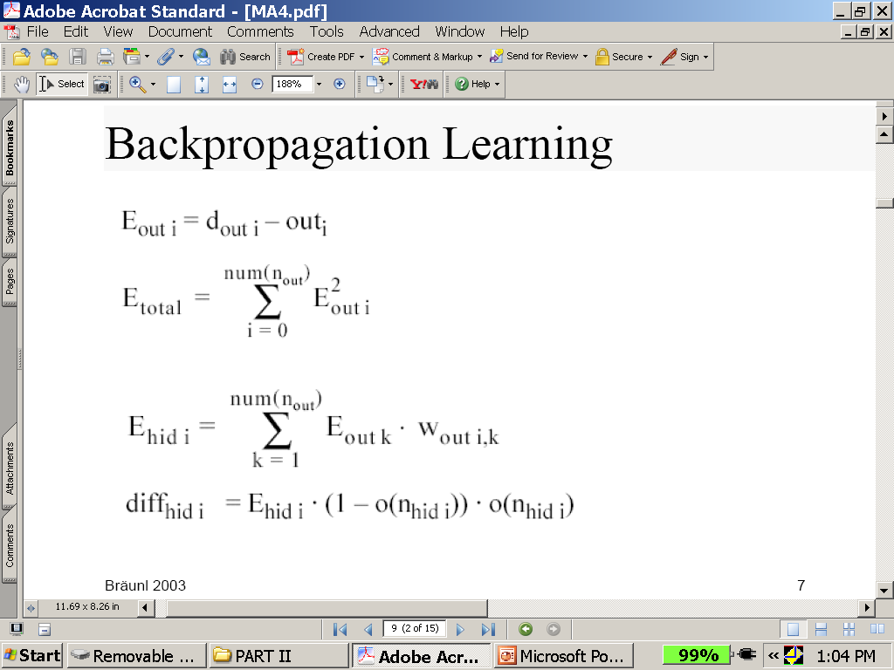
Backpropagation Learning Math
See next slide for explanation

Slide 93
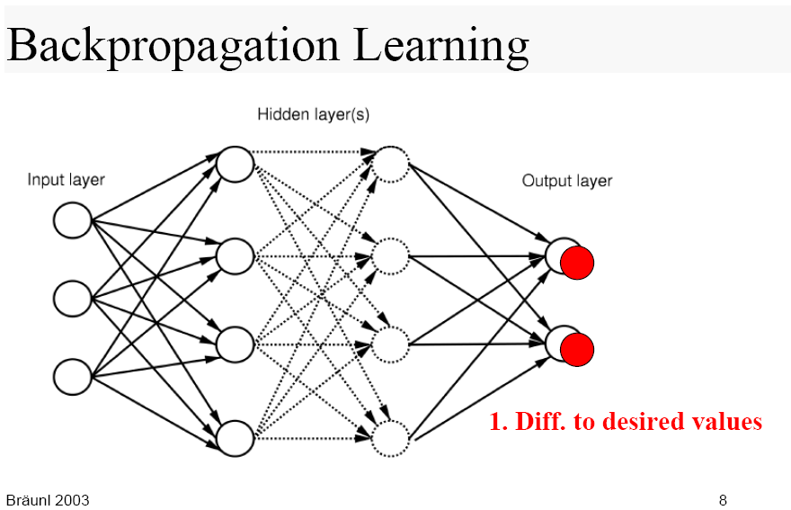
Visualization of Backpropagation learning
Backprop output layer

Slide 94
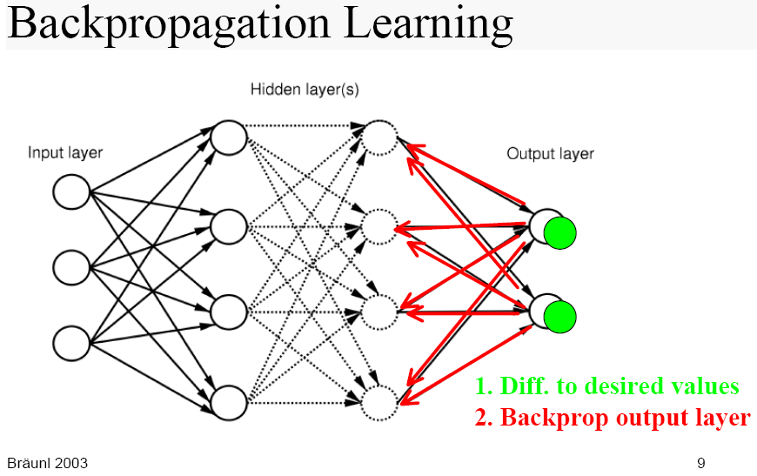

Slide 95
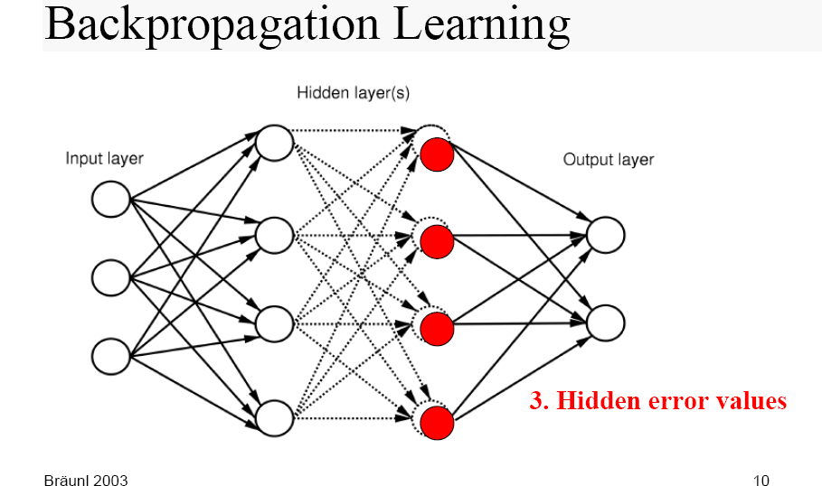

Slide 96
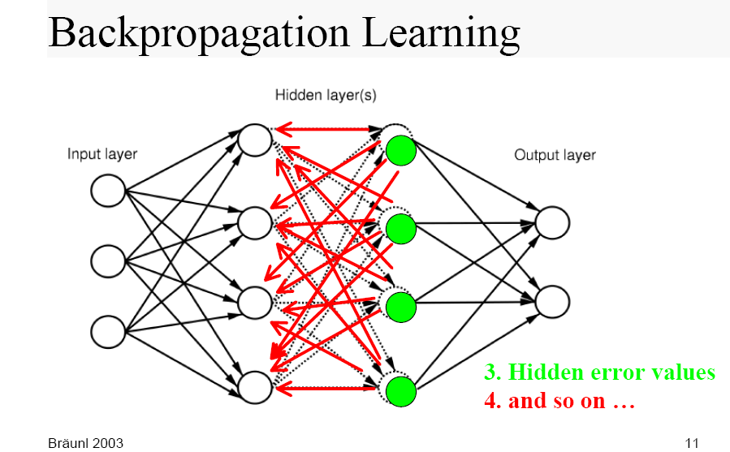

Slide 97
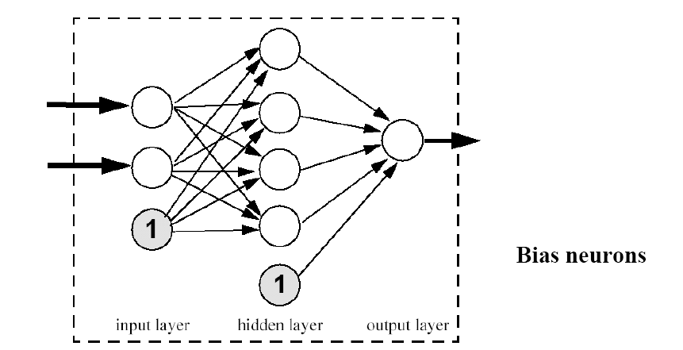
Bias Neurons in Backpropagation Learning
bias neuron in input layer

Slide 98
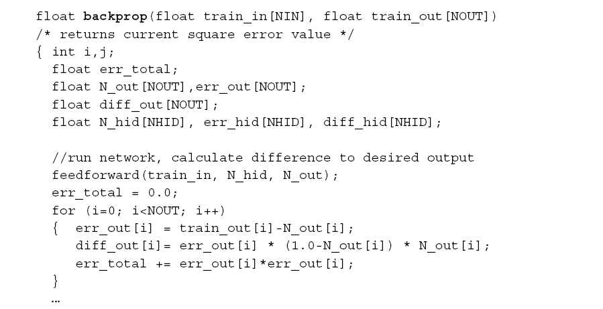
Software for Backpropagation Learning
This routine calculate error for backpropagation
Training pairs
Run network forward. Was explained earlier
Calculate difference to desired output
Calculate total error

Slide 99
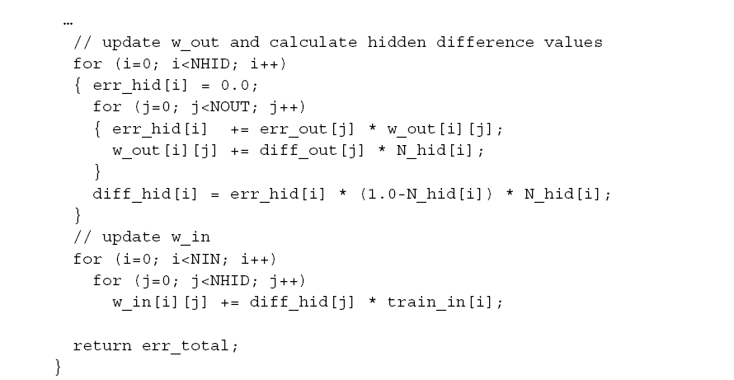
Software for Backpropagation Learning continuation
Here we do not use alpha, the learning rate
Update output weights
Calculate hidden difference values
Update input weights
Return total error

Slide 100
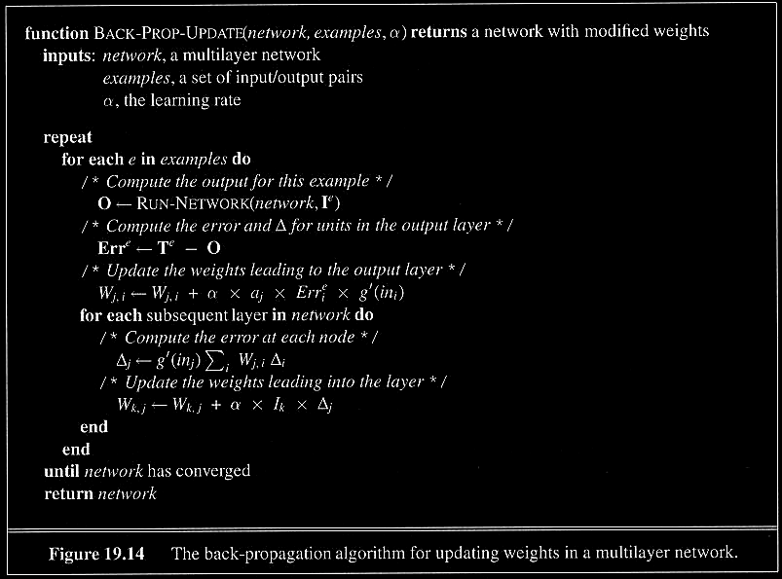
The general Backpropagation Algorithm for updating weights in a multilayer network
Here we use alpha, the learning rate
Repeat until convergent
Go through all examples
Run network to calculate its output for this example
Compute the error in output
Update weights to output layer
Compute error in each hidden layer
Update weights in each hidden layer
Return learned network

Slide 101
Examples and Applications of ANN

Slide 102
Neural Network in Practice
NNs are used for classification and function approximation or mapping problems which are:
- Tolerant of some imprecision.
- Have lots of training data available.
- Hard and fast rules cannot easily be applied.

Slide 103
NETalk (1987)
Mapping character strings into phonemes so they can be pronounced by a computer
Neural network trained how to pronounce each letter in a word in a sentence, given the three letters before and three letters after it in a window
Output was the correct phoneme
Results
  95% accuracy on the training data
  78% accuracy on the test set

Slide 104
Other Examples
Neurogammon (Tesauro & Sejnowski, 1989)
  Backgammon learning program
Speech Recognition (Waibel, 1989)
Character Recognition (LeCun et al., 1989)
Face Recognition (Mitchell)

Slide 105
ALVINN
Steer a van down the road
  2-layer feedforward
    using backpropagation for learning
  Raw input is 480 x 512 pixel image 15x per sec
  Color image preprocessed into 960 input units
  4 hidden units
  30 output units, each is a steering direction
Notes:
Teacher values were gaussian with variance 10

Slide 106
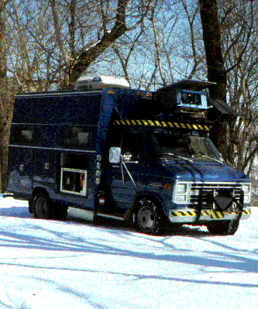
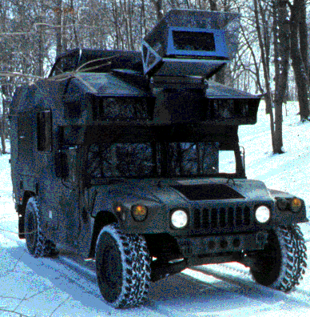
Neural Network Approaches
ALVINN - Autonomous Land Vehicle In a Neural Network

Slide 107
Learning on-the-fly
ALVINN learned as the vehicle traveled
  initially by observing a human driving
  learns from its own driving by watching for future corrections
  never saw bad driving
    didn’t know what was dangerous, NOT correct
    computes alternate views of the road (rotations, shifts, and fill-ins) to use as “bad” examples
  keeps a buffer pool of 200 pretty old examples to avoid overfitting to only the most recent images

Slide 108
Feed-forward vs. Interactive Nets
Feed-forward
  activation propagates in one direction
  We usually focus on this
Interactive
  activation propagates forward & backwards
  propagation continues until equilibrium is reached in the network
  We do not discuss these networks here, complex training. May be unstable.

Slide 109
Ways of learning with an ANN
Add nodes & connections
Subtract nodes & connections
Modify connection weights
  current focus
  can simulate first two
I/O pairs:
  given the inputs, what should the output be? [“typical” learning problem]

Slide 110
More Neural Network Applications
- May provide a model for massive parallel computation.
- More successful approach of “parallelizing” traditional
serial algorithms.
- Can compute any computable function.
- Can do everything a normal digital computer can do.
- Can do even more under some impractical assumptions.

Slide 111
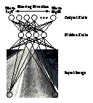

Neural Network Approaches to driving
Use special hardware
ASIC
FPGA
analog
- Developed in 1993.
- Performs driving with
Neural Networks.
- An intelligent VLSI image
sensor for road following.
- Learns to filter out image
details not relevant to
driving.
Output units
Hidden layer
Input units

Slide 112
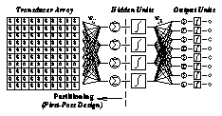
Neural Network Approaches
Input Array
Hidden Units
Output units

Slide 113
Actual Products Available
ex1. Enterprise Miner:
- Single multi-layered feed-forward neural networks.
- Provides business solutions for data mining.
ex2. Nestor:
- Uses Nestor Learning System (NLS).
- Several multi-layered feed-forward neural networks.
- Intel has made such a chip - NE1000 in VLSI technology.

Slide 114
Ex1. Software tool - Enterprise Miner
- Based on SEMMA (Sample, Explore, Modify, Model,
Access) methodology.
- Statistical tools include :
Clustering, decision trees, linear and logistic regression and neural networks.
- Data preparation tools include :
Outliner detection, variable transformation, random sampling, and partition of data sets (into training,
testing and validation data sets).

Slide 115
Ex 2. Hardware Tool - Nestor
- With low connectivity within each layer.
- Minimized connectivity within each layer results in rapid
training and efficient memory utilization, ideal for VLSI.
- Composed of multiple neural networks, each specializing
in a subset of information about the input patterns.
- Real time operation without the need of special computers
or custom hardware DSP platforms
  Software exists.

Slide 116
Summary
- Neural network is a computational model that simulate
some properties of the human brain.
- The connections and nature of units determine the
behavior of a neural network.
- Perceptrons are feed-forward networks that can only
represent linearly separable functions.

Slide 117
Summary
- Given enough units, any function can be represented
by Multi-layer feed-forward networks.
- Backpropagation learning works on multi-layer
feed-forward networks.
- Neural Networks are widely used in developing
artificial learning systems.

Slide 118
References
- Russel, S. and P. Norvig (1995). Artificial Intelligence - A
Modern Approach. Upper Saddle River, NJ, Prentice
Hall.
- Sarle, W.S., ed. (1997), Neural Network FAQ, part 1 of 7:
Introduction, periodic posting to the Usenet newsgroup
comp.ai.neural-nets,
URL: ftp://ftp.sas.com/pub/neural/FAQ.html

Slide 119
Sources
Eric Wong
Eddy Li
Martin Ho
Kitty Wong

